Slide 1
Strategies for Preventing HIV Infection: Stop, Think, and Act
Module 4

Slide 2
For Facilitator: Things to Prepare In Advance
This module's "script" can be directly sourced from the MPC Module 4 tab in the curriculum
Email the Case Study Worksheet (PDF) to students prior to class
Have the “What Should You Do If You Had Unprotected Sex? And “How to Tell Someone You Have and STD” videos prepared and pre-loaded for smoother presenting of video
Plan to Split Students into 2 teams for Rapid Round (Renamed from AIDS Basketball)
Type up the last 20 statements and put into slides (1st 4 are done for you)
Be prepared to keep track of team members as you go through rounds

Slide 3
Group Agreements (Place holder)
….

Slide 4
Stop, Think and Act
STOP
Why might you need to stop if you are being pressured sexually?
THINK
What might you need to think about?
ACT
Evaluate possible consequences and make the best choice

Slide 5
Stop, Think & Act
Stop
Stay calm, take a deep breath
Get control of myself
Think
What is the problem?
What am I being pressured to do?
What am I feeling? What is the other person feeling?
What are my choices?
What do I want?
How do I stay in control?
What alternatives can I suggest?
What are the possible consequences?
Act
Evaluate the possible consequences
Make the best choice
How well did it work?
Get help, if necessary
Make a new choice
Notes:
**Add Animations

Slide 6
Sean and Morgan Case Study
Problem solving using
stop, think and act
Notes:
How does the age difference between Morgan and Sean affect their relationship? Do they have trust, respect, equality and open communication?

Slide 7
Directions
We will work in pairs to look at the Sean and Morgan case study. We will provide you with a handout and with your partner, please fill out the handout.
So, here is the case study
Notes:
(Use breakout rooms or have students use the chat to work with partner)

Slide 8
Sean & Morgan case study
Sean is 3 years younger than Morgan. They’ve been going out for awhile. Sean really likes being with someone who is older. Morgan is a lot of fun, and Sean feels more mature and popular when they’re together.
Sean is very smart and plans to become a psychologist. Sean has had a tough childhood and very much wants to be independent and successful as an adult. Morgan really likes Sean. Lately, Morgan’s friends have been talking a lot about sex, and keep asking if Morgan and Sean have “done it” yet. Morgan figures it’s time and begins to pressure Sean about having sex.
Case study continued on next slide...

Slide 9
Sean & Morgan Case Study Continued
When Morgan ask Sean about having sex, Sean feels unsure about what to say. Sean has thought a lot about this and doesn’t feel ready for sex yet. Yes, Morgan is sexy and Sean feels turned on. But Sen wants to wait until after High School and maybe even college to have sex. Sean does not want to do anything that might interfere with future goals. Sean wants to be able to help young people deal with issues and problems. Sean is also afraid of getting an STD and doesn’t want to take any risk.
However, Sean really wants to keep the relationship with Morgan. Sean would be very hurt if Morgan turned to someone else for sex.
Today Sean and Morgan are hanging out at Morgan’s house. Morgan’s grandparents are out for a few hours. They’re sitting on the couch, kissing and messing around. They’re both breathing hard and things are getting hot and heavy. What can Sean do to avoid having sexual intercourse?
Work in pairs and use the STOP, THINK and ACT steps to find a solution to the situation on your worksheet.

Slide 10
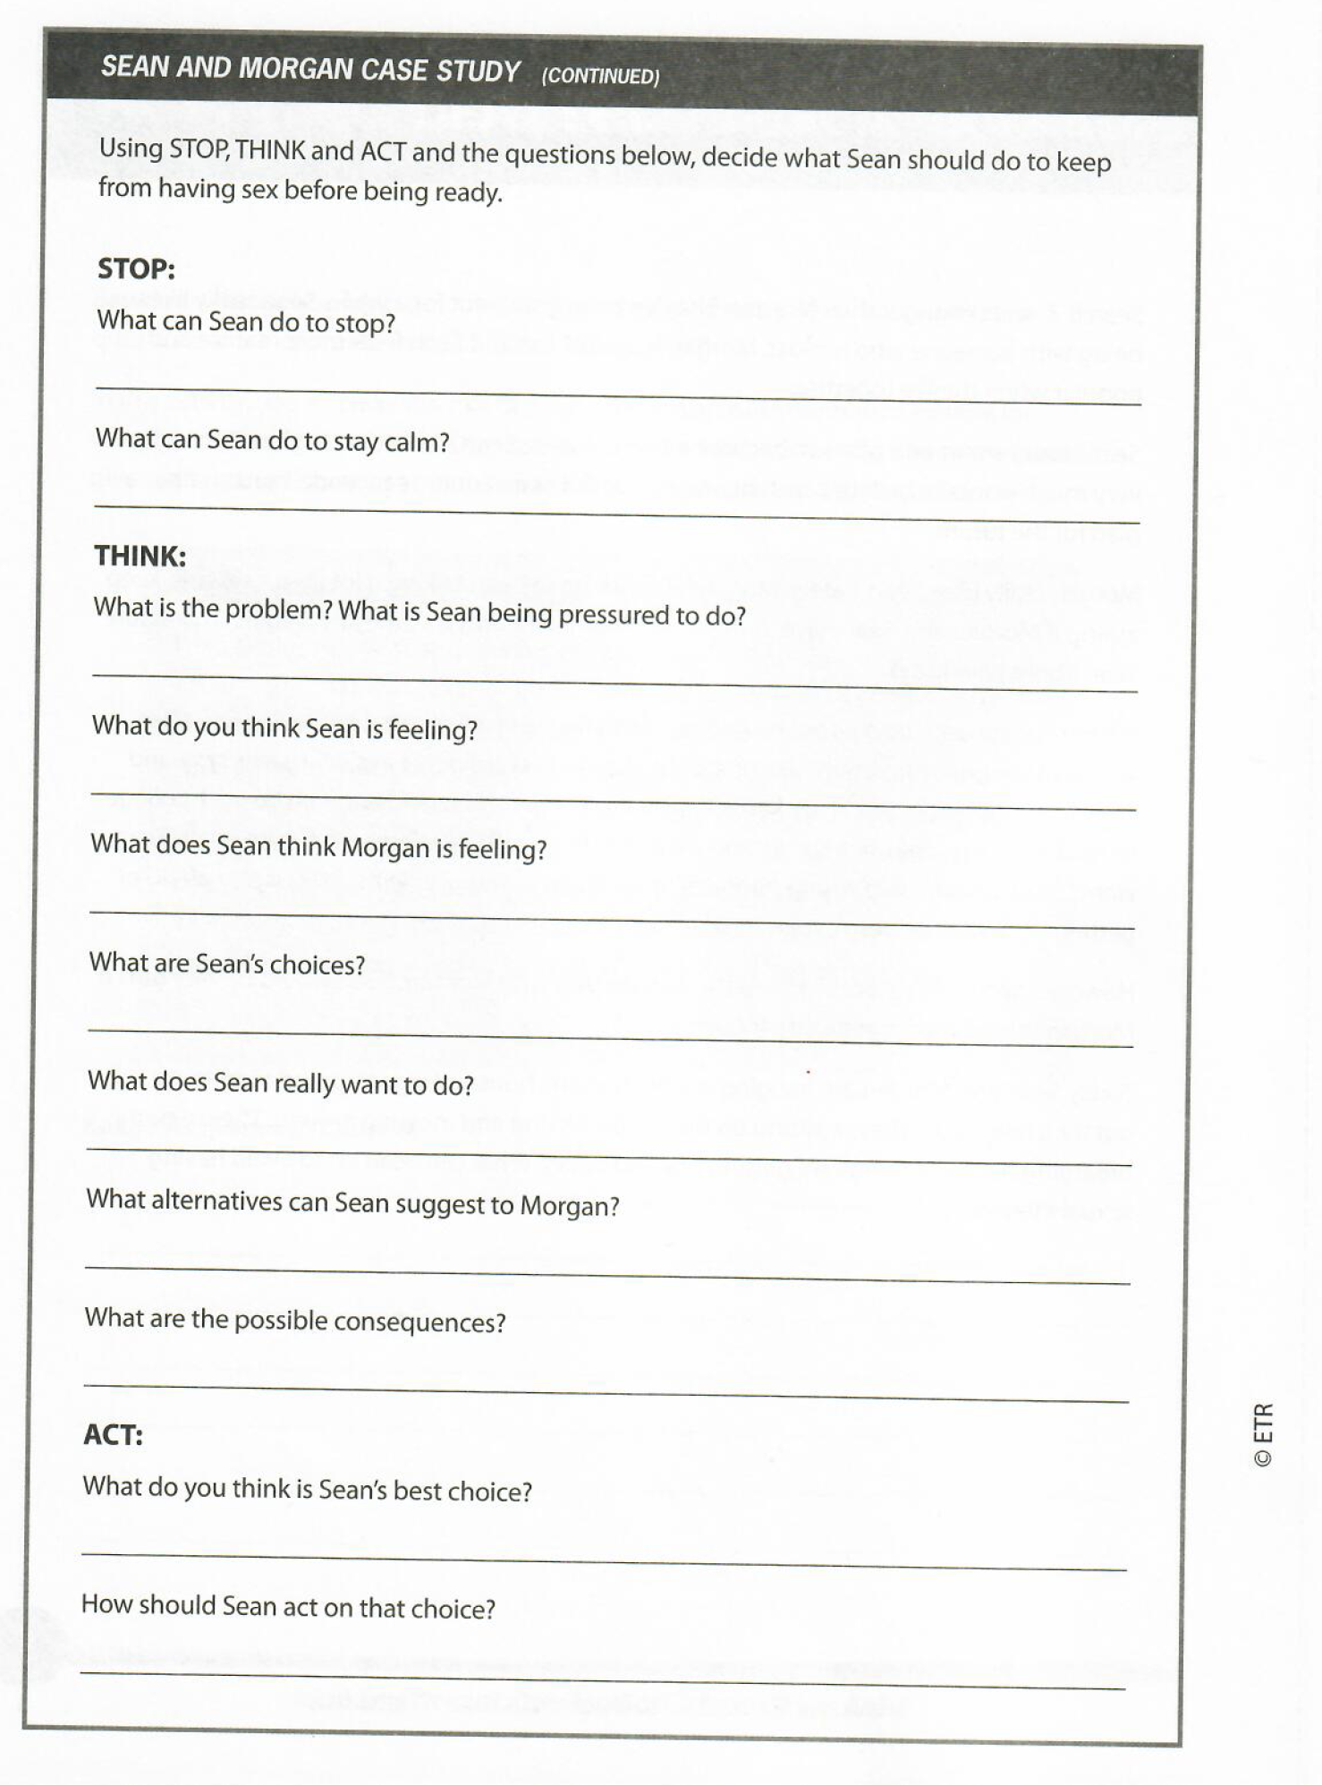
Sean and Morgan Case Study
Take the next few minutes to work in pairs on your worksheet
Once completed, we will come back together to review

Slide 11
DISCUSSION: - What did you and your partner talk about?

Slide 12
What Should You Do If You Had Unprotected Sex?
https://www.youtube.com/watch?v=48zdZ6x3SK4&feature=youtu.be
Notes:
Dec 2020 Edit: Using videos suggested by ETR, not Nicole's Choice.

Slide 13
Video Discussion
What messages did you notice about sex?
What are some potential outcomes of unprotected sex?
What are some things you can do after you have unprotected sex to protect yourself from pregnancy? from STIs?
What communication should happen between partners before sex? After unprotected sex?
What did you notice about the relationship between the provider (nurses/doctors) and youth and accessing healthcare?

Slide 14
How to Tell Someone You Have an STD
https://www.youtube.com/watch?v=xxV7CiE2Bwc&feature=youtu.be

Slide 15
Video Discussion
What important messages were shared about getting an STI and/or living with an STI?
How might it feel to find out you have an STI?
How might it feel to tell someone you have an STI?
How might it feel to have a partner disclose an STI? Before engaging in a sexual behavior? After engaging in a sexual behavior?
What could you do if you found out you or a partner had an STI?
How do respect and healthy communication fit in to conversations with a partner about STIs and testing?
How can you apply what you learned about communication to your relationships?
Notes:
Key Take Aw
Sometimes people may end up having unprotected sex.
If you have unprotected sex, the responsible thing to do is to get tested for STIs. If pregnancy is a concern, get Emergency Contraception as soon as possible following unprotected sex.
It is important to talk with your partner about protecting yourself from STIs. If you or your partner get tested and have an STI, talk openly and receive treatment. ay’s:

Slide 16
HIV/STD Rapid Round Game
Everyone will be divided into 2 groups (Groups A & B)
Each round I will ask an HIV/STI review question and one person will represent each team.
If you guess incorrectly, don't answer at all or are not the first to answer correctly you will be ELIMINATED. (Please only use the chat box)
If both people don’t answer or give incorrect answers a DOUBLE ELIMINATION will happen.
The team that has the most SURVIVORS at the end will win.
(29 rounds) *The number of questions can be adjusted*
Notes:
Make sure it’s clear which students are going each round. The first 4 are in the presentation. Use the rest of the statements from “AIDS Basketball” starting on page 98.
This can also be done in kahoot or another interactive platform.

Slide 17
___
____
____
____
___
____
_____
____
_____
_____
______
_____
______
______
_____
______
______
___
____
____
____
___
____
_____
____
_____
_____
______
_____
______
______
_____
______
______

Slide 18
Round 1 [Insert Team A Name] Vs. [Insert Team B Name]
Can stress transmit HIV?
YES or NO
NO

Slide 19
Round 2
What does AIDS stand for?
Acquired Immunodeficiency Syndrome

Slide 20
Round 3
Which body system does HIV damage?
Immune System

Slide 21
Round 4
Name 3 of the body fluids through which HIV is transmitted.
Semen, vaginal secretions, rectal fluids, blood and breast milk

Slide 22
Round 18
Anyone who has unprotected sex or shares needles can get HIV.
True or False
True
*If you choose to continue, the rest of the questions will look like this, without the names. Announce the names that are left.*

Slide 23
Team update!
How many players are left in each team?
*At this point, facilitator can end the game with most team players as the winning team.*
*If continuing, use next slide as an example of how to do so until all questions are answered*

Slide 24
GREAT WORK!
Look out for program email!
*Insert Contact Info*
Email us if you have any
Questions, Comments, Concerns

