Slide 1
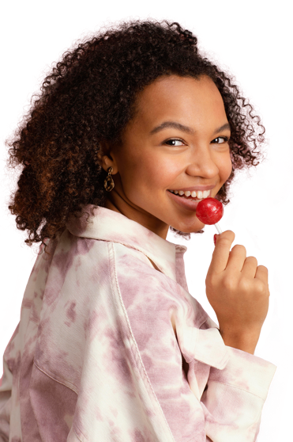
It’s a HAIRY BIG Deal
Presented by Mary Maley & Marisol De Leon
ACT for Youth Center for Community Action
4/13/21

Slide 2
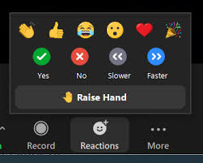
Zoom Keeping/Netiquette
Audio:
Mute when not speaking
Delays?
Close other browsers
Participation:
Zoom reaction features
If using cell or someone else’s link, “rename yourself”
Notes:
Audio: On web meetings, you have control of your audio, but we may mute as well on our end if we hear background noise.
Delays: We will be sharing slides and screens and animated content, so closing other browsers will help.
Recording: Web meeting recordings & PPT slides will be uploaded to the ACT site usually within a week.
Participation:
Engage non-verbally in the presentation by using the reaction buttons at the bottom of your screen.
Using your full name helps us keep track of attendance.

Slide 3
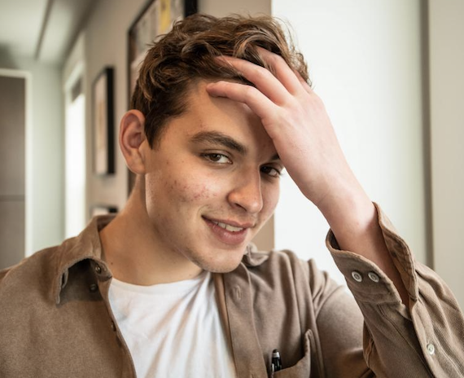
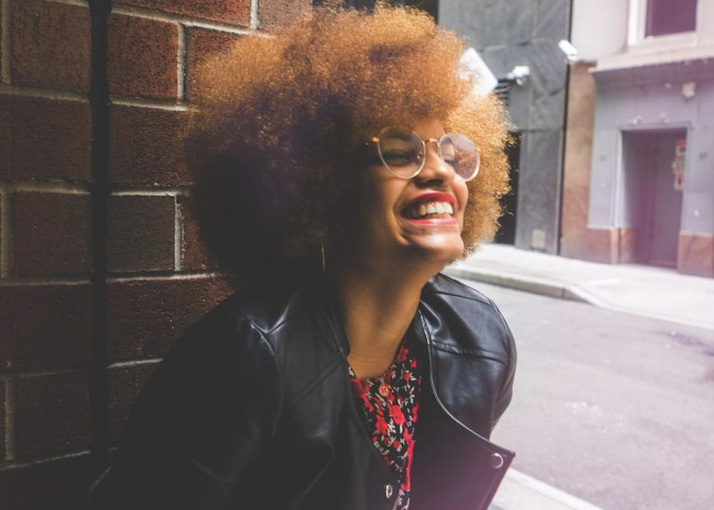
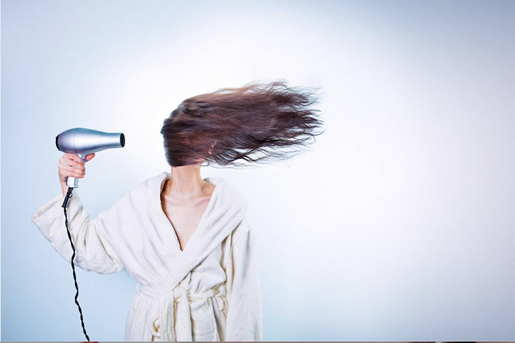
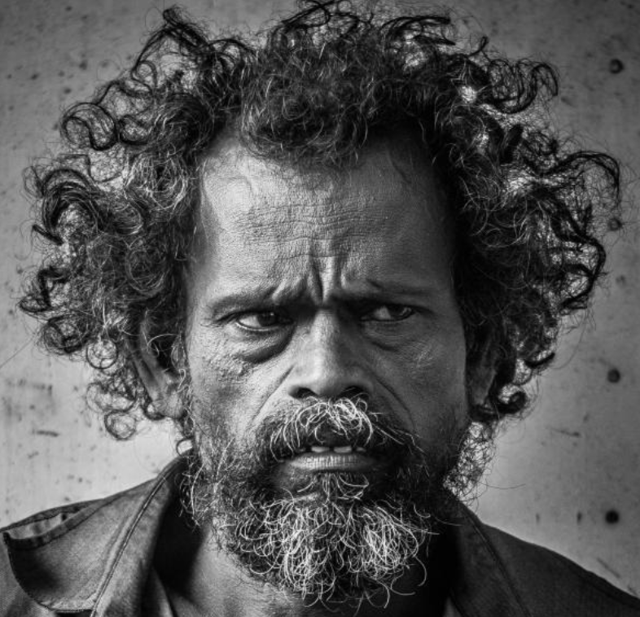
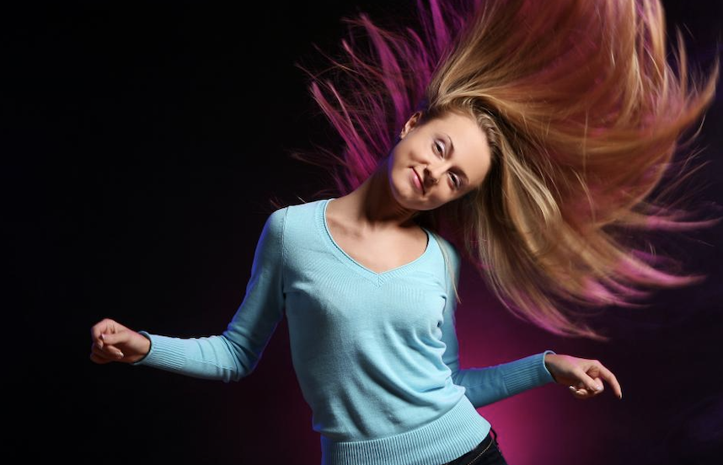
What’s Your Hair Saying Today?
1
2
3
4
5
6

Slide 4
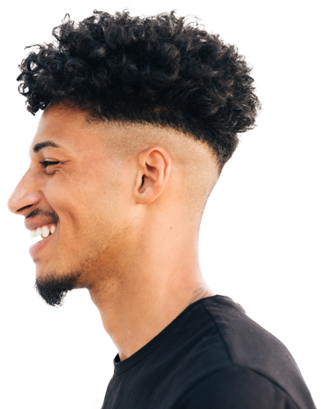
AGENDA
Video 1
Large group reflection
Article discussion
4 breakout room debrief
Breakout room discussion
Resource reference
Video 2
Wrap Up
Notes:
Today we want to talk about messages young people are hearing about hair, and the important ways: Representation, self-esteem and identity are connected to hair
What this webinar is about:
The experience of hair (or lack of hair) is universal, and the feelings we have about our own hair run the complete scale (sometimes changing by the minute and sometimes all at once). Why is Hair so powerful? It can be either the most or least changeable of our outward appearance.

Slide 5
Goal
01
02
03
Space
Time
Safety
Create a space to discuss how this topic has impacted our lives and our work with youth
Create designated time to discuss the topic when otherwise we would not have much time for
Here we will assume best intention to allow folks to speak genuinely and transparently about their experience

Slide 6
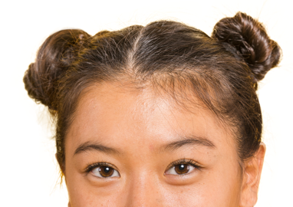
Whoa!
When in breakout rooms:
You'll have a prompt question
Please make sure to hear from at least 3 people.
You will have 5 minutes
We prefer that you unmute and talk to one another.
However, IF you must use the chat function, please chat responsibly
Notes:
Chatting responsible means:
Being aware of what you’re typing
Not getting into side conversations
Allow time/space for responses

Slide 7
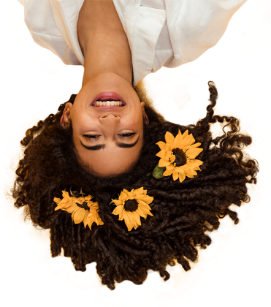
Video 1
Dove | Beauty standards of hair are a form of bias
https://www.youtube.com/watch?v=agptI1_1C40
Notes:
https://www.youtube.com/watch?v=agptI1_1C40

Slide 8
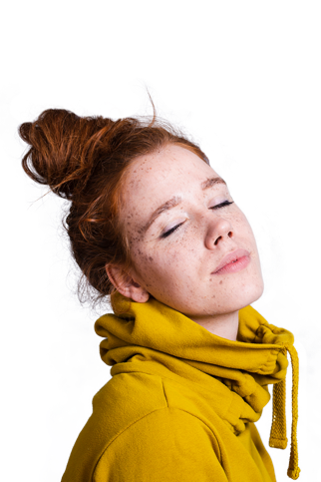
Large Group Discussion
What resonated for you?
What did you learn?
Was there anything missing?
Can you use this information in your work?

Slide 9
Journal Article Discussion
What is this article about?
Notes:
Discuss Historical Context
Mary add content here
Introduce that we will go into 2 or 4 room and discuss the follow paragraph

Slide 10
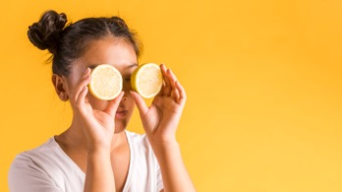
Breakout Room
Measuring Discrimination (The Hair Implicit Association Test)
Types & Contexts of Discrimination
Impact of Hair Discrimination
A call to action:
Policy Development,
training and education,
mental health intervention

Slide 11
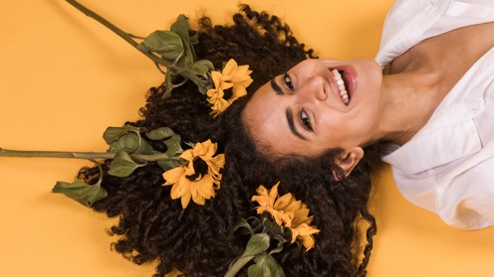
To Discuss
Question 1
Hair bias has been under investigation using an experimental design of attitudes to predict hair discrimination in the lives of Black women and measure unconscious beliefs that shape racial discrimination and stereotypes related to hair. The Implicit Association Test (IAT) focused on measuring our unconscious values that shape our discrimination behaviors,
Question 2
Across the hair stories, texture was the most common basis of hair discrimination. In this category, participants reported receiving differential treatment because of the natural texture of their hair. Texture or curl pattern can be defined as “how tight or loose the curls or coils are of individual strands of hair located on the scalp” A recurrent experience was that of participants who had more tightly coiled hair receiving ridicule or verbal harassment.
Question 3
“One of my friends came up to me and said “okay we get it, you’re Black” and another said “yes, your hair is looking a little nappy today.” I remember being so embarrassed. It took so much effort to achieve that look and to be insulted in such a way where I was made to feel embarrassed about my natural curls prevented me from truly feeling comfortable in my own skin for a long time.”
Notes:
If there

Slide 12
To Discuss
Question 4
Training and education.
The narrative data suggests that there should be hair-based professional development for teachers in schools and hair-influenced educational curriculum for students. Not only should school policies be extended to include hair discrimination as a form of bullying of Black children, but teachers should be trained in antibias techniques related to hair and school staff should be prepared to process experiences related to aesthetic trauma. Black children and adolescents report that they personally struggle in coping with criticism received from their peers, but also are in a stage of struggling to properly take care of their natural hair in a healthy format. It is recommended that hair care professionals offer trainings on the complexities of Black hair to school administrators, faculty, school counseling staff, and especially school students. With peers being the most likely to be the perpetrator of hair discrimination, and school being the most common environment, consistent discussions surrounding hair dis- crimination should be reported and processed in this academic environment.

Slide 13
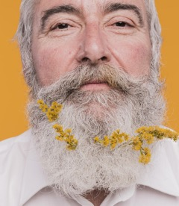
Large Group Share

Slide 14
What you’ll walk away with… If want to look deeper, here are some additional articles & videos

Slide 15
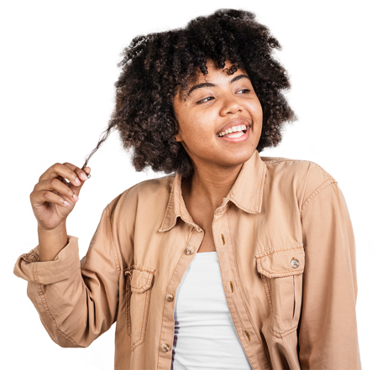
Further Readings & View
Articles;
Employment Discrimination
https://digitalcommons.law.byu.edu/cgi/viewcontent.cgi?article=3177&context=lawreview
Resource:
Teaching Workshop (Description) for Educators
https://www.dcareaeducators4socialjustice.org/news/hair-representation-in-childrens-literature
Research
Connection & Identity in Black Culture
https://www.crresearch.com/blog/connection-between-hair-and-identity-black-culture
Don’t Get it Twisted (Sent via PDF.)
Video Links:
Allure; Girls Talk About Hair
https://www.youtube.com/watch?v=Mx-xg8dsvKQ
Love Hair
https://www.youtube.com/watch?v=kNw8V_Fkw28
Dove; Love your Curls
https://www.youtube.com/watch?v=bSKRN3w0m1w
Dove; Beauty Standards/Hair Bias
https://www.youtube.com/watch?v=agptI1_1C40

Slide 16
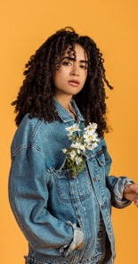
Before we Go…
Video 2
Love Your Curls
https://www.youtube.com/watch?v=bSKRN3w0m1w
Notes:
https://www.youtube.com/watch?v=bSKRN3w0m1w

Slide 17
Thank You!
Mary Maley
MM153@cornell.edu
Heather Wynkoop Beach – haw48@cornell.edu
Jutta Dotterweich - jd81@cornell.edu
Michele Luc – ml782@cornell.edu
Marisol De Leon
md696@cornell.edu

