Slide 1
The Power of Relationships
CAPP, PREP, SRAE Webinar
March 18, 2021

Slide 2
Zoom Keeping/Netiquette
Audio:
Mute when not speaking
Recording will be available on the ACT site
Delays?
Close other browsers
Participation:
- Zoom reaction features ➡️
- If using cell or someone else’s link, “rename yourself”

Slide 3
Foundations of learning and development
Key elements of developmental relationships
Reflect on your own experience
Intentionally building developmental relationships

Slide 4
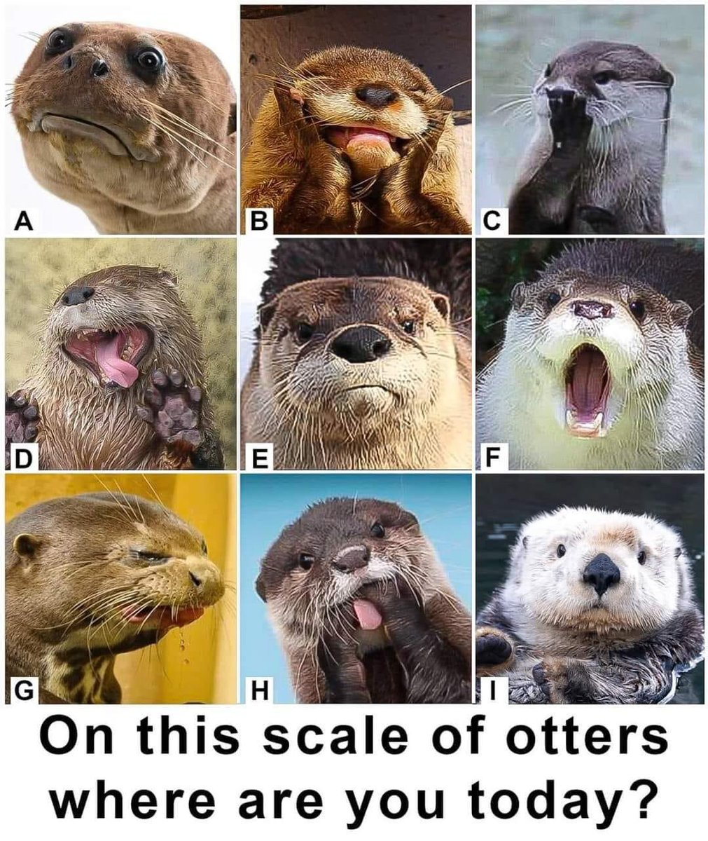
Checking in

Slide 5
Resiliency research has shown that the single most important factor to overcome adversity and do well is to have at least one stable and committed relationship with a supportive parent, caregiver, or other adult.
Relationships Are Key
Werner & Smith. 1992

Slide 6
Foundations of Development and Learning
Resources:
Science of Learning and Development Science Alliance https://www.soldalliance.org/
Edutopia video: The Science of Learning and Development - YouTube

Slide 7
Development
A dynamic process that is shaped by ongoing,
reciprocal interactions between children’s biology,
their developing brains and their physical and social
contexts

Slide 8
Neuroscience says
Brain is malleable/plastic
Growth happens through experiences and relationships
No two young people learn precisely in the same ways
Rich learning environments integrate social-emotional and cognitive/academic learning

Slide 9
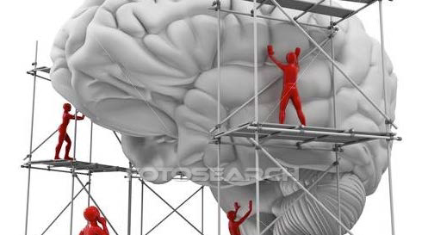
Cells (neurons) are the building blocks of different structures within the brain (gray matter) Nerve fibers/tracts form the highways between them Major critical regions are built first, then joined together, then specialized Stimulation and activity molds how strongly each pathway works
Brain Works
Growth spurts: infancy & adolescence

Slide 10
Context matters Youth are active agents
Laws/Norms
Economics
Peer
Family
Role models
School
Youth
Faith Communities
Neighborhood
Work
Media/Internet

Slide 11
Toxic Environments
Impact development
Adverse Childhood Experiences (ACEs) study
Poverty/Disparities
Neuroscience responds
Supportive relationships counter stress
Oxytocin (“love” hormone) versus Cortisol (stress hormone)

Slide 12
o Relationships: The science tells us that relationships are the active ingredient in the learning environment, and the antidote to toxic stress. o Routines: The brain is a predictive machine, and is calm when things are orderly, making routines and consistency vital pieces of environments that encourage brain development. o Resilience: The key to building resilience is recognizing that we all – adults and youth alike – have strengths to build upon. Asset-based approaches allow us to help them understand and manage their emotions.
The New 3 Rs

Slide 13
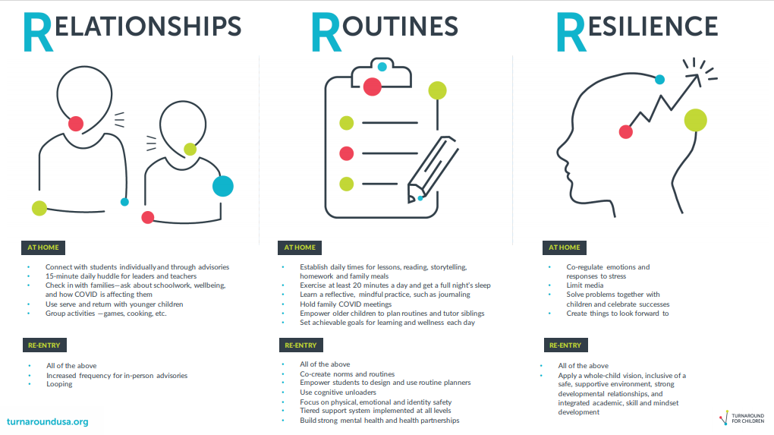
Resources For The New Three Rs: Relationships, Routines and Resilience | Turnaround for Children (turnaroundusa.org)

Slide 14
Reflection
Think back to your own adolescent years - middle or high
school years:
What did supportive relationships with adults look like?
How would you describe them?

Slide 15
How can we be more intentional in developing supportive relationships?
Supportive relationships are characterized by sensitivity, attunement, consistency, trustworthiness, cognitive stimulation and scaffolding Osher et al. 2018

Slide 16
Developmental Relationships
Developmental relationships are the active ingredients of effective interventions.
They are characterized by
attachment/connection
reciprocity
progressive complexity
balance of power
Simple interactions are the building blocks; relationships emerge from
accumulated interactions.
Li & Julian. 2012

Slide 17
Simple Interactions Tool
Simple Interactions https://www.simpleinteractions.org/

Slide 20
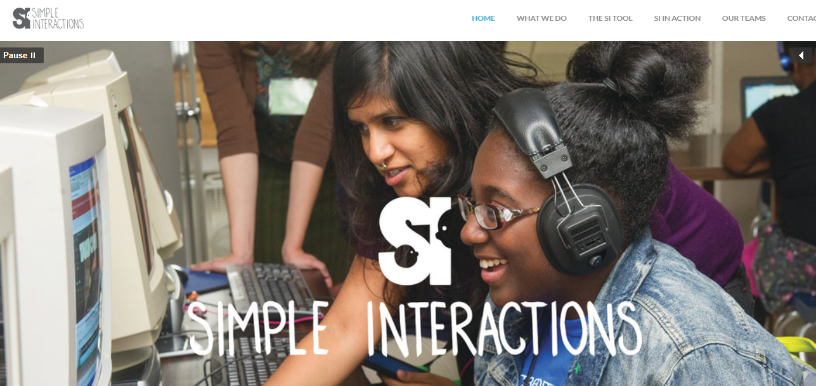
SIMPLE INTERACTIONS - HOME

Slide 21
How could you apply these strategies?
How could you use this tool in your workplace?

Slide 22
A promising approach to professional development Akiva. T. et al. 2016

Slide 23
Search Institute’s Developmental Relationship Framework https://www.search-institute.org/developmental-relationships/developmental-relationships-framework/
Express Care
Challenge Growth
Provide Support
Share Power
Expand Possibilities

Slide 27
Any thoughts or comments?

Slide 28
12,796 youth
6-12 grade
12% OST
7% Student Support
Insights-Evidence-DRs-DEI.SEL-FINAL.pdf (search-institute.org)

Slide 30
1. Showing them that they can trust me 2. Giving them individual attention 3. Helping them learn from mistakes & failures 4. Holding them accountable for their actions 5. Building their self-confidence 6. Standing up for them when they need it 7. Taking their ideas seriously 8. Involving them in important decisions 9. Inspiring them to see future possibilities 10. Introducing them to new people, places, and ideas
Poll: How much attention are you giving to each of the actions listed below in your interactions with young people?
Source: Relationships Check Tool (search-institute.org)

Slide 31
Impact of strong developmental relationships
Young people are more likely to report a wide range of social-emotional strengths and competencies
Demonstrate academic strengths and civic commitment
Are more resilient in the face of stress and adversity
Impact amplifies when young people have a web of strong relationships

Slide 32
Building Developmental Relationships 4 Ss Interview
Sparks: What are your talents and passions?
Strengths: What are your abilities and values?
Struggles: What keeps you up at night?
Supports: People and places where you can be yourself?
4Ss interview: https://www.search-institute.org/wp-content/uploads/2019/08/4-Ss-Interview-download.pdf
Kent Pekel’s Ted Talk: https://www.ted.com/talks/kent_pekel_getting_relationships_right

Slide 33
Questions?
Takeaways?
Thank You!

Slide 34
Resources
ACT for Youth: Youth Work Professionals
http://www.actforyouth.net/youth_development/professionals/
Turnaround for Children
Turnaround for Children (turnaroundusa.org)
Search Institute
Search Institute-- Helping Young People Be and Become Their Best Selves (search-institute.org)
Simple Interactions
SIMPLE INTERACTIONS - HOME

Slide 35
References
Werner, E. E., & Smith, R.S. (1992). Overcoming the odds: High-risk children from birth to adulthood. Ithaca, NY: Cornell University Press
Li & Julian.2012. Developmental Relationships as the Active Ingredient: An Unifying Working Hypothesis of “What Works” Across Intervention Settings. American Journal of Orthopsychiatry. Vol 82, No. 2, 157-166
Akiva. et al. 2016. Simple Interactions: Piloting a Strengths-Based and Interaction-Based Professional Development Intervention for Out-of-School Time Programs. Child Youth Care Forum. 46:285-305
Pamela Cantor et al. 2018. Malleability, plasticity, and individuality: How children learn and develop in context. Full article: Malleability, plasticity, and individuality: How children learn and develop in context1 (tandfonline.com)
David Osher et al. 2018. Drivers of human development: How relationships and context shape learning and development. Full article: Drivers of human development: How relationships and context shape learning and development1 (tandfonline.com)

