Slide 1
Virtual Observation and feedback Heather Wynkoop Beach ACT for Youth

Slide 2
Housekeeping
Recording
Audio/Visual
Participation
Will be available online.
Close out other tabs.
Mute when not speaking.
Use the chat box or unmute.
Notes:
Before we begin, I will make sure we are recording, that subtitles are on and go over the housekeeping.
Other ACT team members are on and will monitor the chat as well and mute when necessary for me. I’ll take breaks to check the chat every so often.

Slide 3
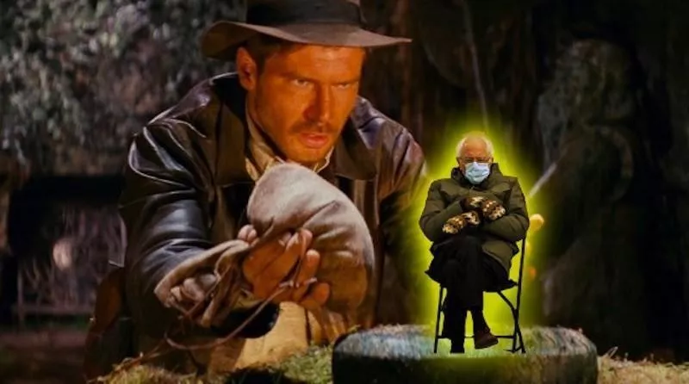
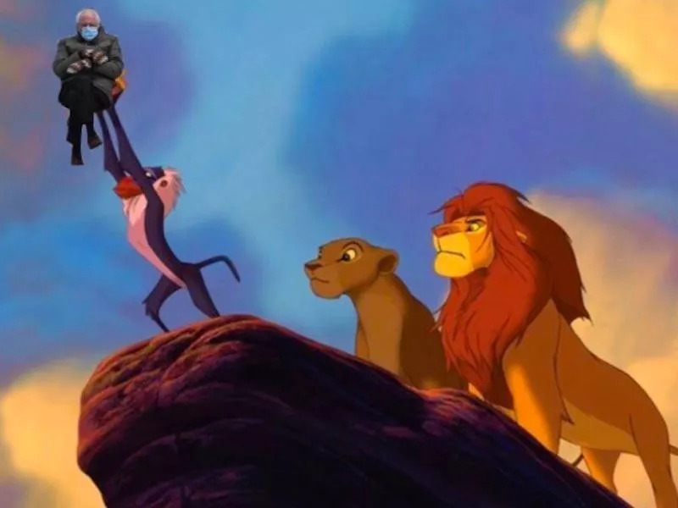
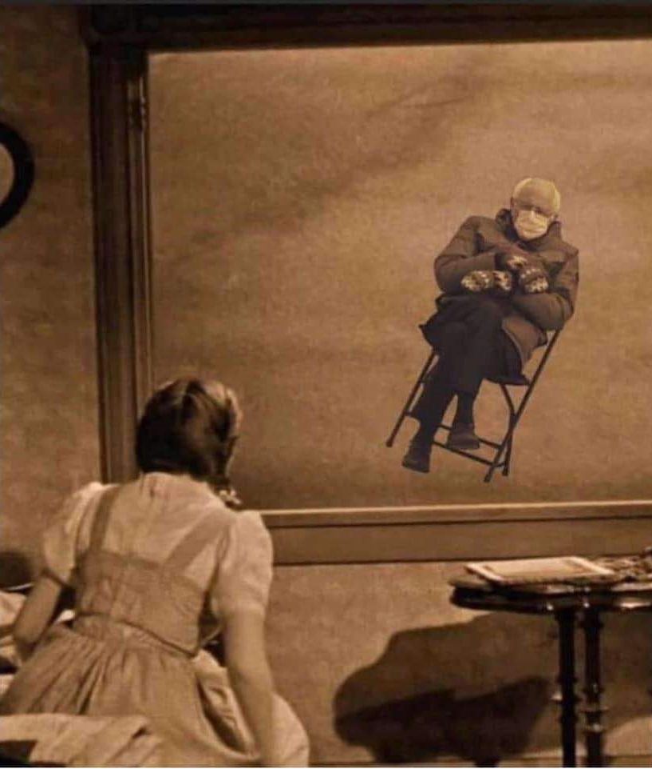
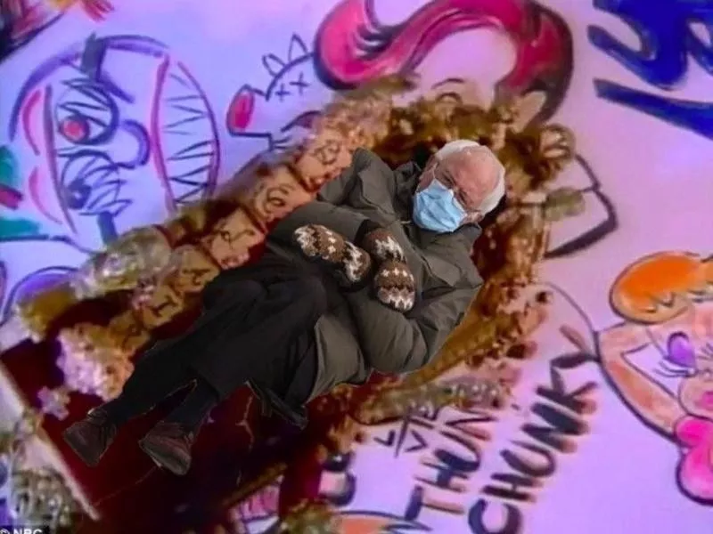
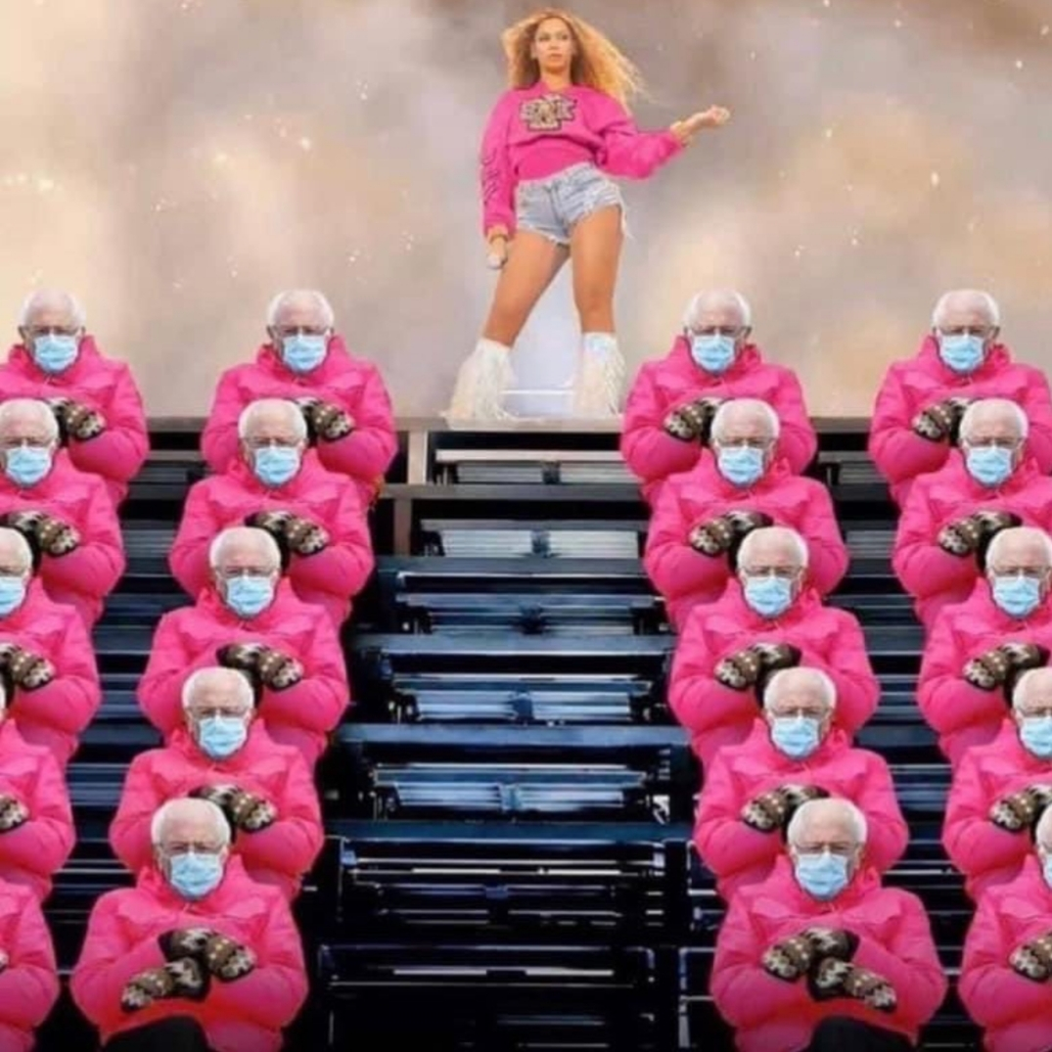
Which Bernie Meme are you?
1
3
2
5
4

Slide 4
Agenda
Observation Requirements
Before you begin
Protocol and VFOF
Feedback
Facilitation Improvement Plan
Notes:
A quick agenda review. If there is anything you think won’t be covered that you have questions about, please put it in the chat.

Slide 5
Why Observe?
To identify both strengths and areas in need of improvement or change which gives way for professional growth.
It’s an opportunity for facilitators to engage in reflective dialogue about their work.
Offers supervisors insight into where staff may need additional support.
We know that successful implementation of EBP’s does not solely rely on the curriculum.

Slide 6
It’s also required
ACT for Youth
SRAE and PREP: 1 per year.
CAPP 1 per grant cycle (most still due).
We keep record. Site and DOH get copy.
Health Educator Supervisors
Must observe each educator 2x a year.
If YOU implement, you must be observed by your supervisor.
If sub-contract, their supervisor must observe them and send report to you.
Report in BAR and records stay with you.

Slide 7
Protocol and Virtual Facilitator Observation Form
CAPP/PREP
SRAE

Slide 8
Before you begin
Decide on a session that will highlight the interaction between the educator and students
(Typically, the 1st and last don’t work well)
If it is with students outside the organization, get permission from the site and communicate about parental permission requirements
Review Virtual Facilitator Observation Form with educator and discuss rating descriptions
Decide how you will be introduced to students
Schedule time to discuss feedback

Slide 9
Observation
Be familiar with the session module. Know what activities are scheduled to be completed, their purpose and how they are to be implemented.
Introduce yourself to the class and then turn off your camera and microphone for the entirety of the session
Take notes throughout on what you observe
Notes:
You should have the activity breakdown, either from the manual or the Virtual Implementation Plan, with you.

Slide 10
What to Look For

Slide 11
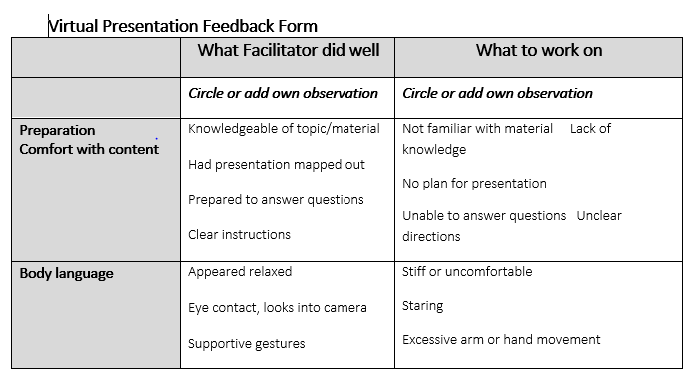
Notes:
This form will be up on the website soon.

Slide 12
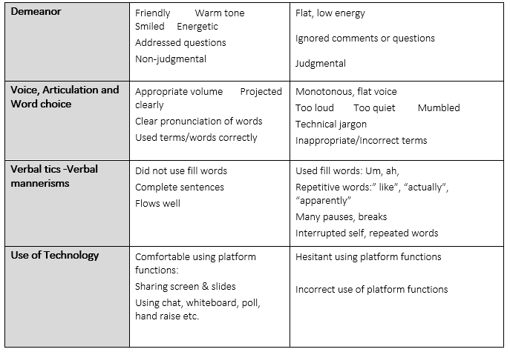

Slide 13
Feedback
Notes:
Remember the purpose of observation and feedback is to:
To identify both strengths and areas in need of improvement or change which gives way for professional growth.
It’s an opportunity for facilitators to engage in reflective dialogue about their work.
Offers supervisors insight into where staff may need additional support and training.

Slide 14
Johari Window
Known to Self
Not Known to Self
Known to Others
Not Known to Others
Notes:
If you aren’t familiar with this, this is a Johari window. Created in 1955 by Joseph Luft and Harry Ingham, the model is used to help individuals better understand themselves and how they are perceived by others. Fun fact: it’s called “Johari as an incorporation of both their 1st manes. Long before Bennifer!
Known by me and others: What I’m wearing, name, profession, etc..

Slide 15
Johari Window
Known to Self
Not Known to Self
Open-To-Public
Self
Known to Others
Not Known to Others
Notes:
Johari window: developed by Joseph Luft and Harry Ingham to help people understand interpersonal communication and relationships.
Four aspects of our total self.
Self-awareness: things we know, don’t currently know about ourselves
Others’ knowledge of us: things they know and don’t know about us

Slide 16
Johari Window
Known to Self
Not Known to Self
Open-To-Public
Self
Known to Others
Private Self
Not Known to Others
Notes:
Private: What I choose not to share: (Fear of heights…)

Slide 17
Johari Window
Known to Self
Not Known to Self
Known to Others
Open-To-Public
Self
Not Known to Others
Private Self
Unknown
Self
Notes:
Unknown to both: Unconscious stuff that’s not visible (this is where therapy may spend its time)

Slide 18
Johari Window
Known to Self
Not Known to Self
Open-To-Public
Self
Blind Self
Known to Others
Unknown Self
Private Self
Not Known to Others
Notes:
The Blind Self: You see it, but I don’t (toilet paper on the foot, my strange laugh, tics, some personality traits, etc.)

Slide 19
How does feedback fit in?
Notes:
So how does the notion of feedback fit into this?

Slide 20
Johari Window
Known to Self
Not Known to Self
Open-To-Public
Self
Blind Self
Known to Others
Unknown Self
Private Self
Not Known to Others
Notes:
What quadrants are we trying to affect?
First is where we ASK for feedback
Second is where we offer

Slide 21
Johari Window
With effective feedback…
Known to
Self
Not Known to Self
Open to public self
Known to Others
Blind Self
Unknown Self
Not Known to Others
Private Self
Notes:
With effective feedback, parts of your habits that are unconscious come to light.
Learning how we’re perceived helps us make conscious decisions in our educating.

Slide 22
Feedback That Works!
The Situation, Behavior, Impact (SBI) Model
Maureen Kelly, PPSFL

Slide 23
effective Feedback:
Makes information useful to others
Allows you to replicate and improve performance
Is developmental in nature (toward improvement)
Is direct and clear
Is behaviorally anchored (based on what you see)
Is non-evaluative and non-judgmental

Slide 24
Warm and Cool Feedback
Cool
What do you want to work on?
What would you want to do different in the next session?
Was there anything the students should have come away with that they didn’t?
Warm
What went well?
What would you want to repeat in another session?
What skills or understandings did the students take away from this session?
Notes:
It’s important to go into the feedback session with the expectation that there will be things the educator did well, and things they could work on.

Slide 25
Situation
Specific event/ circumstance grounded in time and space.
This date, during this event, at this meeting.
Anchors feedback in time and space.
Helps person getting feedback understand the context of what they are hearing
When you presented BC methods 1st period…

Slide 26
Behavior
Observable actions (what you saw or heard)
Verbal comments
Nonverbal behaviors and signals
Notice mannerisms and physical presence
Allows the person receiving feedback to know specifically how they behaved
Behaviors are things that can be recorded, they are seen and heard
Important Note: *check-in on your own inferences when observing behaviors (SELF AWARENESS IS KEY!)
You spoke clearly and concisely. You provided details when making your point and you answered questions directly

Slide 27
Impact
What I (or others) think, feel, or do as a result of what I observed
“I saw.…. I heard.… I felt.… I thought.….”
It is not an interpretation or judgment on motivation or intent
Share thoughts, feelings, and actions as a result of the individual's behaviors on the task AND on the group
.“.…when you did those things, the students seemed confident in the information you were sharing and felt comfortable asking several follow up questions. That makes a positive difference in the classroom..”

Slide 28
Putting it all together
“When you presented BC methods 1st period, you spoke clearly and concisely. You provided details when making your point and you answered questions directly. when you did those things, the students seemed confident in the information you were sharing and felt comfortable asking several follow up questions. That makes a positive difference in the classroom..”
“What did you think of my session?”

Slide 29
EBP Facilitation Improvement Plan
If any individual items on the observation form are rated 1 or 2, the HES/SRAE Coordinator will work with the educator to address the professional development need.
If the overall assessment of the program session is 1 or 2 (3 = average) the HES/SRAE Coordinator will develop an improvement plan in conjunction with the educator. The ACT TA Provider will be available to assist and support professional development needs to improve the quality of program delivery. The educator will not implement an EBP cycle until the improvement plan is completed. Once this is done, the educator can co-facilitate the EBP with an experienced educator.

Slide 30
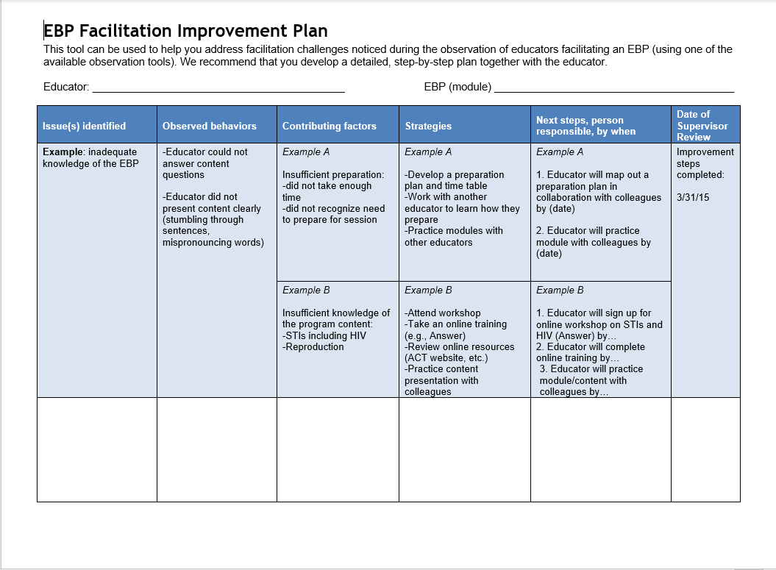

Slide 31
Questions?

Slide 32
THANK YOU!
Heather Wynkoop Beach
haw48@cornell.edu

