Slide 1
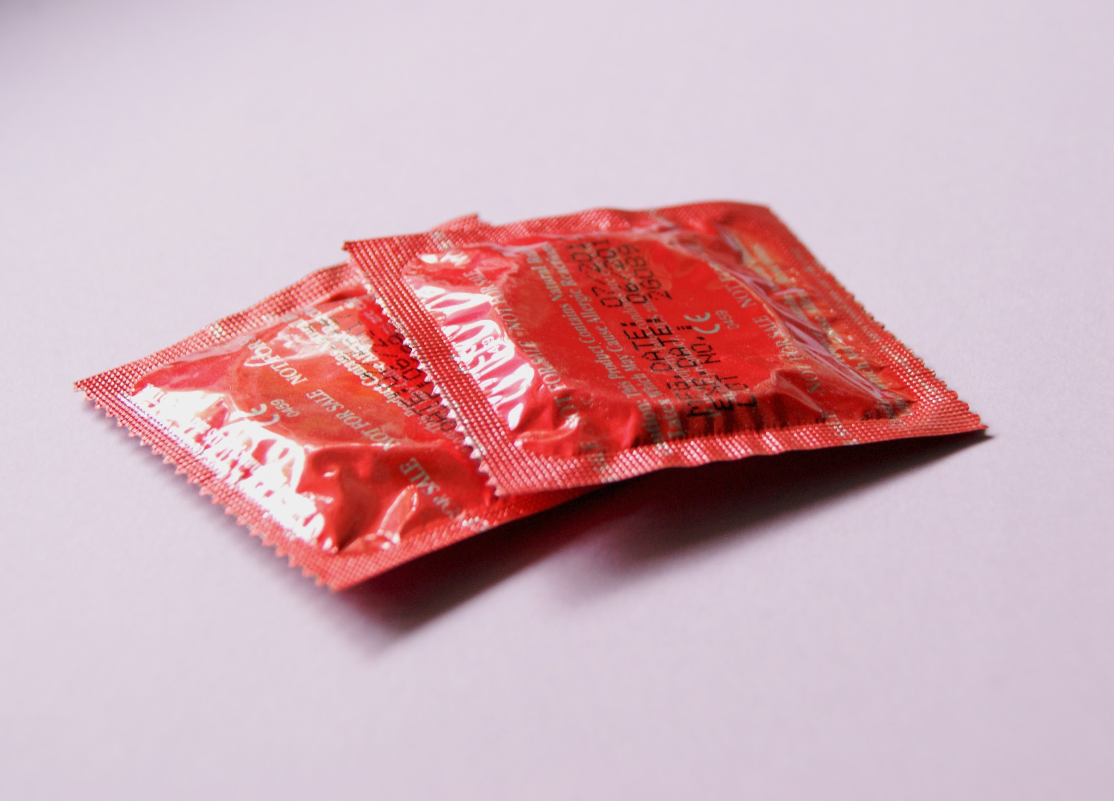
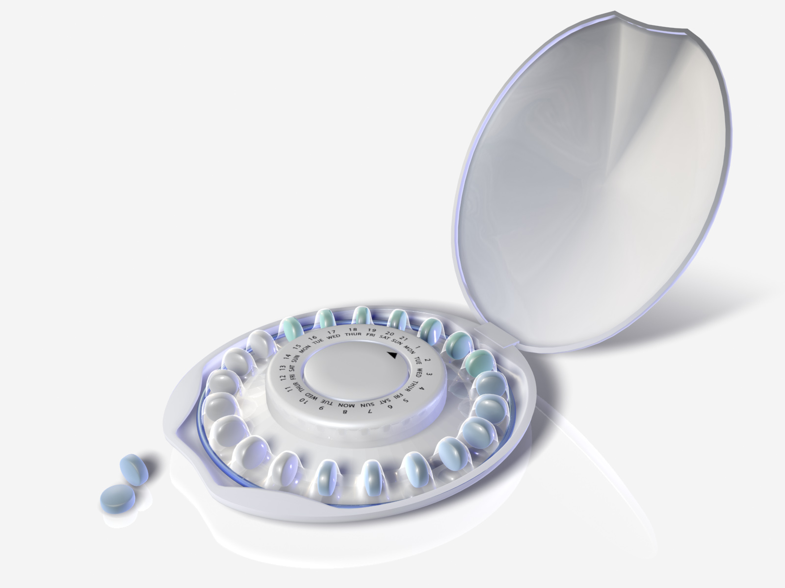
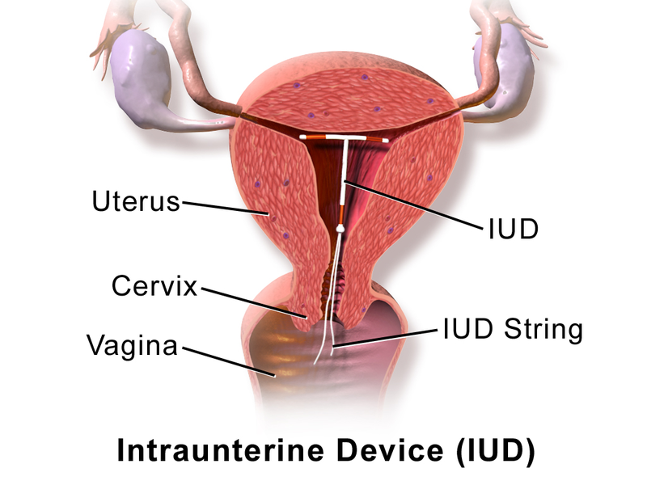
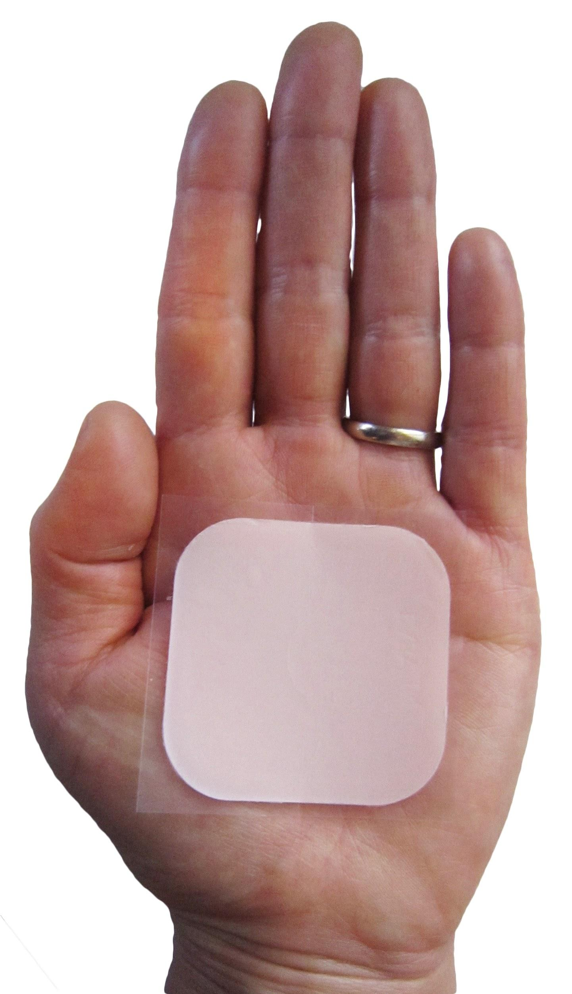
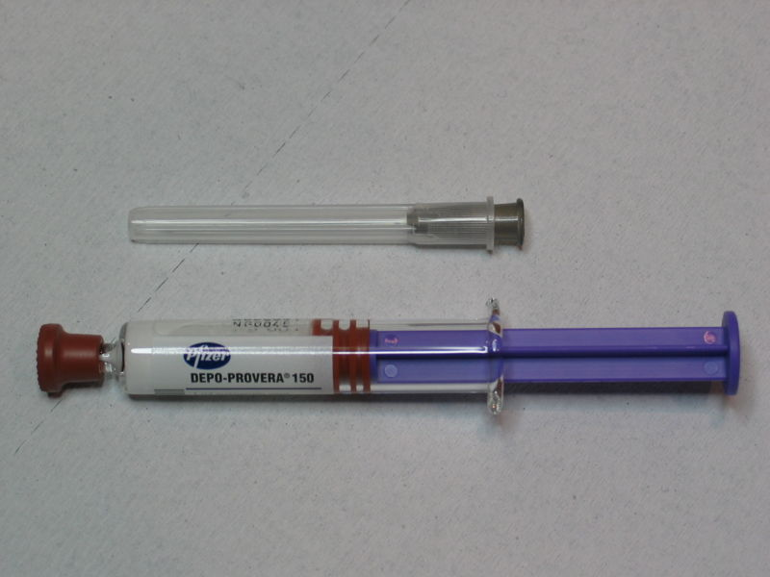
Birth Control Methods Demonstration

Slide 2
Contraceptives Brainstorm
What are some methods of birth control that you’ve heard of?
Please write your responses in the chat box

Slide 3
Video
There are lots of options to choose from when it comes to birth control. Here’s a video that will give you more info, then we’ll discuss it afterwards.
Birth Control: The Final Frontier (Amaze) - https://amaze.org/video/birth-control-the-final-frontier/

Slide 4
Video Discussion
What did you learn about birth control methods?
What are long acting reversible contraceptive methods (LARCs)?
Why might different people choose different birth control methods?
What factors do you think impact someone’s birth control choice?

Slide 5
Let’s break it down! There are 2 types of contraceptive methods
Barrier/Over-the-Counter
Hormonal/Prescription
Available at:
Clinics
Drug stores & supermarkets
Schools & CBOs
--------------------------------------------
Examples
External (male) condoms
Internal (female) condoms
Spermicides
Need to see a health provider (clinic or private MD) to access:
IUD
Implant
Depo-Provera (the shot)
Birth control pills
Patch
Ring

Slide 6
Let's not forget about abstinence
What does it mean?
Not engaging in sexual intercourse of any type (oral, anal or vaginal)
Avoid activity that might result in exchange of bodily fluids and skin- to- skin contact
Requires skill: knowing when to say no to risky sex in an assertive manner
Have a backup plan in case you decide to stop using abstinence
ABSTINENCE IS THE ONLY BIRTH CONTROL METHOD THAT IS 100% EFFECTIVE!

Slide 7
Types of prescribed hormonal methods
These work by releasing hormones that prevent ovulation (when the ovaries release their eggs).
A doctor must prescribe these
Hormonal methods DO NOT prevent STDs/HIV. You should still use a condom to protect yourself.
IUD (* Hormonal---there’s also a Non-hormonal IUD)
Implant
Depo -Provera (the shot)
Birth control pills
Birth control patch
Vaginal ring

Slide 8
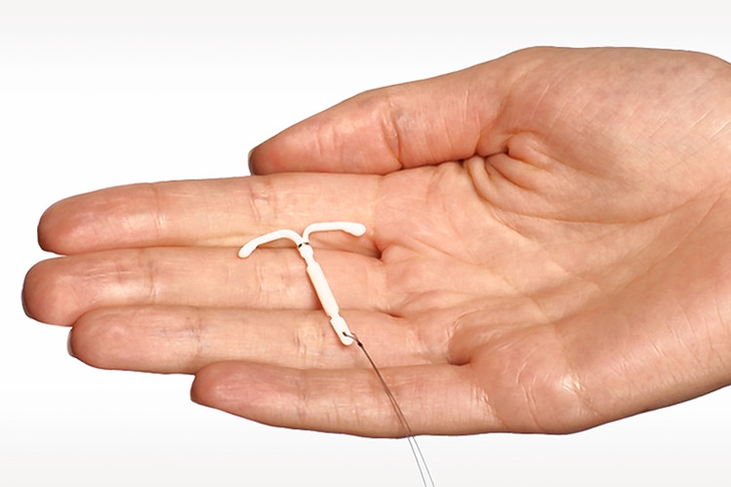
IUD (Intrauterine Device)
Small T-shaped device that is inserted into the uterus
99% Effective
Releases hormones to prevent ovulation
Hormonal
Mirena (up to 5 yrs), Skyla (up to 3 yrs) & Liletta (up to 3 yrs)
At first can cause heavier or more painful periods
Spotting may occur during the first 6 months, then lighter periods

Slide 9
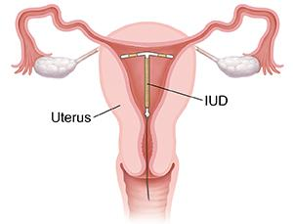
IUD (Intrauterine Device)
Non-Hormonal→ The copper-T IUD
Paraguard - Provides protection from pregnancy for up to 10 years
Creates an environment in the uterus that makes it very hard for sperm to survive and for fertilized eggs to attach to the wall of the uterus
99% effective

Slide 10
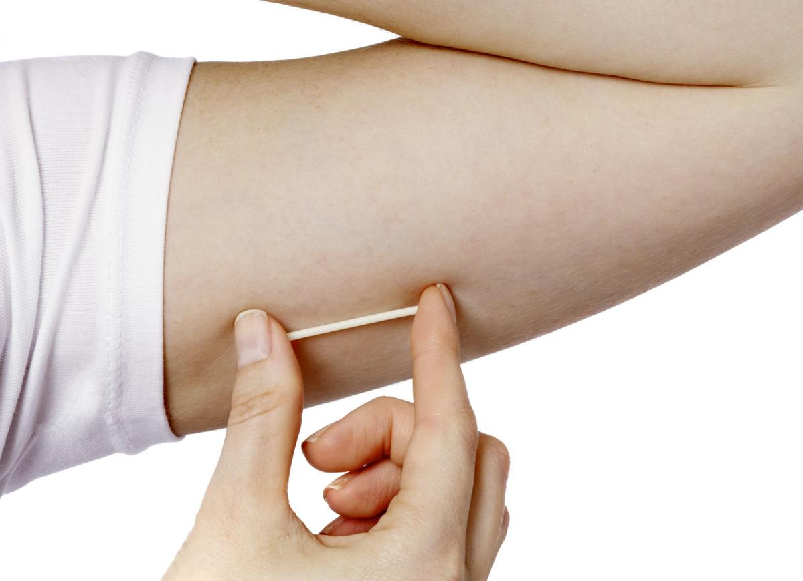
Implant
Thin matchstick-sized rod placed under the skin of your upper arm
Releases hormones to prevent your body from releasing eggs
Can be used up to 3 years
Can cause periods to be irregular or stop
99% effective

Slide 11
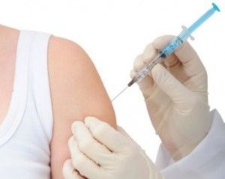
Depo- Provera AKA The Shot*
Hormonal injection given every 3 months by a medical professional
Between 94-97% effective
Becomes effective within 24 hrs.
Once discontinued, it may take up to 10 months to conceive

Slide 12
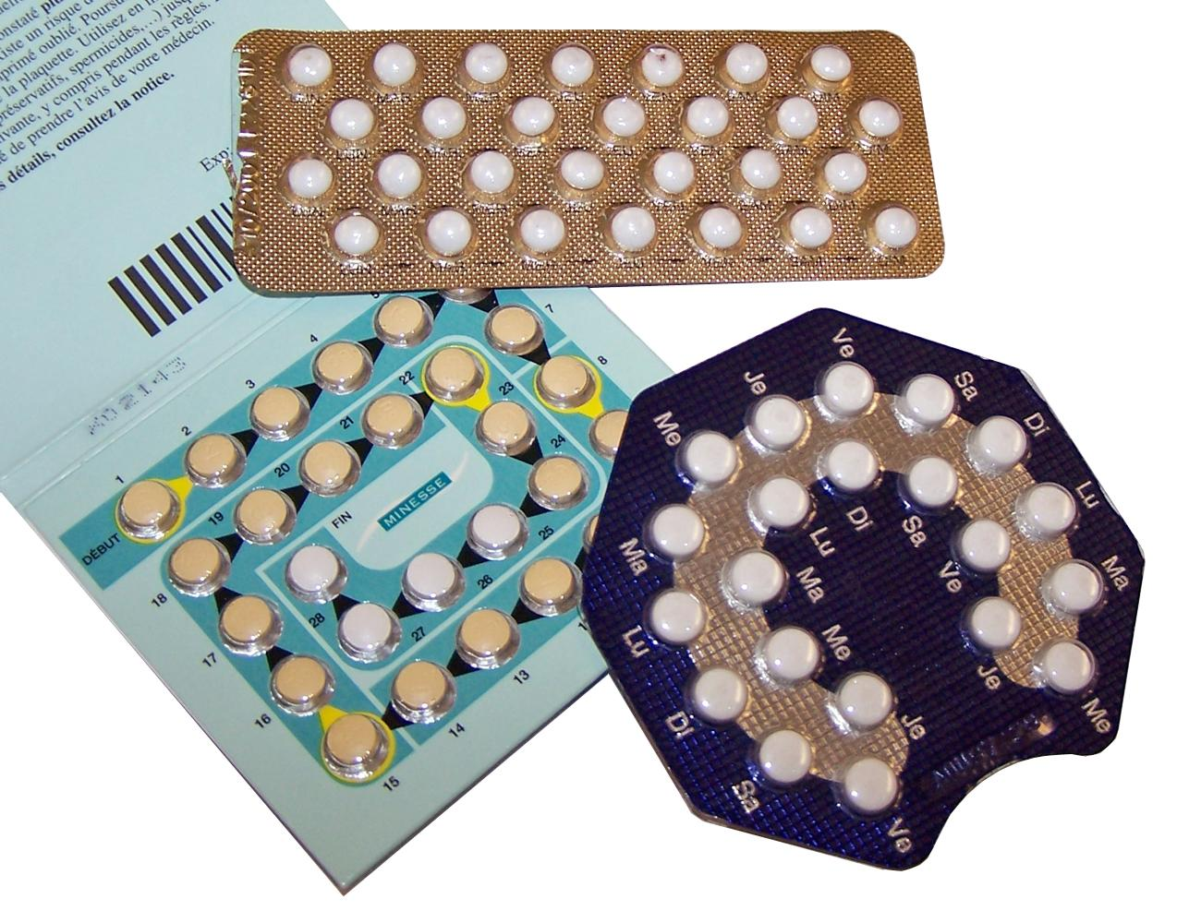
Birth Control Pills*
Prevent the ovaries from releasing an eggs during the monthly cycle
One pill must be taken each day at about the same time
From 91-99% effective
Must use backup for the first 7 days to prevent pregnancy
If you miss a day, you must take 2 pills the next day
If you miss more than one day, you must use a backup method for 7 days to prevent pregnancy and talk to your provider about finishing the rest of your pack of pills

Slide 13
Birth Control Patch*
A small band-aid like sticker that you wear on either your back, hip, butt, or upper outer arm
Works the same as the pill (releases hormones to prevent ovulation) except your skin will absorb the hormones on the patch instead of you swallowing the pill
Change once every 3 weeks
On the 4th week, you don't wear it and get your period.

Slide 14
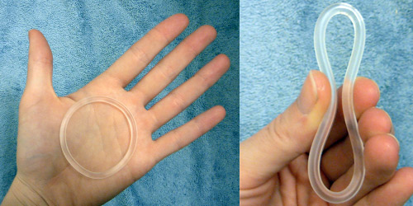
Vaginal Ring*
Flexible ring inserted into vagina and sits below the cervix
Prescribed by a medical professional
Releases hormones that are absorbed through the vaginal walls
Leave it in for 3 weeks and then take it out the 4th week to have your period
91-99% effective

Slide 15
Disclaimer for Hormonal Methods
These methods are very effective, but they have side effects. Smoking cigarettes does increase the risk of experiencing these side effects which may include:
Irregular menstrual bleeding and spotting
Nausea
Weight gain
Headaches/migraines
Dizziness
Breast tenderness
Mood changes
Blood clots

Slide 16
Recap
When it comes to prescribed contraceptives there are a lot of effective methods for you to use.
They are also low maintenance, so you don't have to worry about them all the time.
Speaking to a health provider can help you choose which method works best for you.
Research shows with the help of long-acting methods teen pregnancy rates have gone down dramatically.

Slide 17
Over The Counter Methods
External (Male) condoms
Internal (Female) condoms
Sponge
Spermicide

Slide 18
Barrier Methods (Condoms)
External (male)
A latex sheath that covers the penis and keeps semen from entering the partners body
Should be put on while the penis is erect
Removed after ejaculation, away from the partner
Some people are allergic to latex, use polyurethane or polyisoprene instead
Internal (female)
Soft, loose fitting plastic or nitrile sheath that lines the vagina or anus (made of strong material, unlikely to break or tear)
Can be inserted right before sex up to 8 hours before
Lambskin condoms do not protect against HIV, so do not use them!

Slide 19
Let’s Test What You’ve Learned
Put your answer in the chat box, then we’ll review!
Birth Control Kahoot: https://create.kahoot.it/share/3fd6d899-a5a3-4a8f-b96c-41c19a733394
Answer Key: https://teachingsexualhealth.ca/app/uploads/sites/4/Gr8TM-KahootKey-Birth-Control.pdf
Quiz from Teaching Sexual Health.ca (https://teachingsexualhealth.ca)

Slide 20
Let’s summarize
Some things that should always be on your mind when having sex is unintended pregnancies and sexually transmitted diseases incl. HIV
Use of the these methods can help you avoid these problems.
Use latex, polyurethane/polyisoprene condom in addition to any other form of contraceptive you choose.
In order to reach your goals and dreams, the proud and responsible thing to do is to use effective methods of protection every time you have sex!

