Slide 1
Building Negotiation and Refusal Skills
Be Proud! Be Responsible! Module 6

Slide 2
Energizer: Would You Rather….
Would you rather give up your phone or your friends?
Would you rather be dressed up or dressed down all the time?
Would you rather have only Instagram or TikTok?
Would you rather wear your clothes backwards or inside out?
Would you rather get one free international trip or unlimited flights within the U.S.?
Notes:
Facilitator Note: Select a few ice breaker questions to fire up virtual engagement. Some example questions are provided. You can use Zoom Polls, the chatbox, or simply allow participants to “voice by choice” by unmuting their lines.

Slide 3
Activity A. Introduction and Overview
Welcome to the last session of Be Proud! Be Responsible!
In this session, we will work on HIV prevention skills like…
Negotiating condom use
Negotiating abstinence
Notes:
Say: Welcome to the last day of Be Proud! Be Responsible! Today we will apply everything we’ve learned and practice HIV prevention skills. We will learn how to negotiate with a partner to use condoms or to abstain from having sex.

Slide 4
Questions?
Before we start our last module, do you have any thoughts, feelings, reactions, or questions about how to use condoms and make condoms fun?
Notes:
Say: Before we get started, I want to take a moment to reflect. <Insert Zoom poll if desired> Are there any thoughts, feelings, reactions, or questions about how to use condoms or make condoms fun? Please feel free to share using the class chat, private chat, or unmute your line to comment.

Slide 5
Activity B. “What to say if my partner says…”
Let’s brainstorm excuses for not wanting to use a condom. Write your ideas in the chat box!
Notes:
Say: In module 5, we discussed barriers to using condoms consistently. One barrier is a partner who doesn't want to use condoms. At some point, you may have a sexual partner who gives excuses for not wanting to use a condom. Let’s brainstorm excuses sexual partners might give. Share your ideas in the chat box/Google Doc/out loud by unmuting yourself.

Slide 6
How can you respond to excuses?
Let’s turn each of these excuses into a good reason to use condoms. For example:
Excuse: I don't like the way condoms feel
Response: “I can show you how to make them feel much better! There are different styles and sizes!”
Now’s your turn! Let’s respond to the other excuses.
Notes:
Say: Let’s see if we can change each excuse into a good reason to use condoms. For example if a partner says…”I don't like the way condoms feel.” then you could respond by saying “I can show you how to make them feel much better.” or “There are different styles and sizes we can use” .
Allow participants respond to other excuses they brainstormed. You may also use the excuses listed in the curriculum on the following two slides.

Slide 7
"Condoms kill the
mood for sex"
“Condoms don’t feel as good as the real thing... they aren't natural”
“Let's just do it once without a condom. I promise to be careful”
Only if you let it. With a little imagination, it can enhance sexual feeling and make your erection last longer too!
OR
Let me show you that it doesn’t have to kill the mood…
Today's thin latex condoms feel quite natural. Placing a drop of lubricant inside the tip of the condom can also create added sensation.
Once is all it takes to create a problem such as an unplanned pregnancy or passing on an STI.
“People who use condoms don't trust each other”
“Really? Did you cheat on me and catch something?
“We never used condoms before… why now?
It's not a matter of trust… it’s about caring for your sexual health and that of your partner too.
In fact, both of us share the responsibility for having and using condoms. Trust has nothing to do with that.
Yes, I’m aware but that was a mistake because I didn’t know better.
Now that I do, I want us to stay protected because I really care about our health and hope you do too.
No, and I’m disappointed that you would think that.
I really care about our relationship and wont allow an unplanned pregnancy or life altering STI affect that. I hope you feel the same way.
Notes:
Click on the first excuse, then allow for participants to come up with responses for that excuse. Allow for periods of silence as participants may be thinking about potential responses &/or typing in their response in the chat box. After about 1 min. or after all responses have been shared, click on the screen again to reveal possible responses.
Repeat this process for the remaining 5 excuses on the page. Time permitting, you can continue this activity with the responses on the following slide, or you can end this activity once you have responded to 6 excuses on this page.

Slide 8
We don't need to use condoms if you’re on the pill!
I love you. How can you think I would give you an infection?
I’m sorry, I don’t have a condom on me
The pill doesn't help protect you from STI’s or HIV but condoms are the only protective method that can.
You wouldn't do it intentionally. Most people don’t show common symptoms and aren’t even aware that they’re infected with an STI.
Let’s kiss and cuddle without having intercourse
OR
Let's go to the clinic and get some condoms for the next time we try having sex.
Condoms are for people with diseases. Do I look sick to you?
Hey, I'm disease free. I haven’t had sex with anyone in months.
I can’t…
I'm allergic to latex.
Unfortunately, you can't tell by looking at people if they have an STD. A person can look and feel healthy—and still be possibly infected.
As far as I know. I could be free of diseases too but we can never be sure unless we get tested.
OR
Either of us could have been exposed to an infection from a previous relationship and never know if we don’t show symptoms.
I’m so glad you told me. Let’s use a polyurethane or polyisoprene condom. They’re made for people who have latex allergies.
Notes:
After going through selected excuses, say: Those are great responses! Keep this activity in your mind. We will use this information later to practice the SWAT technique. No matter what excuse your partner gives, be prepared to respond in a way that helps you make the responsible choice to use condoms (or dental dams) every time you have sex.

Slide 9
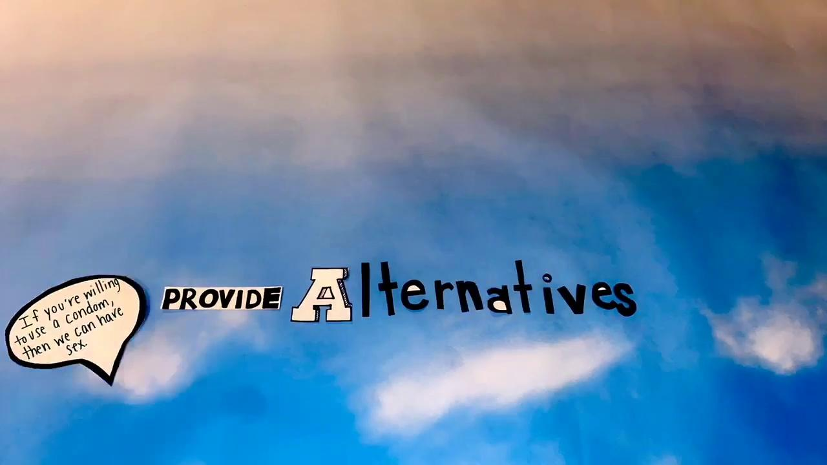
Activity C. Using the SWAT Technique
Notes:
Say: Knowing what’s best for your health and doing something about it are two different things. Even though condom use prevents the transmission of STDs like HIV, bringing up the subject with a partner can be difficult. But, it’s still important to talk with your sexual partner(s) about condoms and safer sex. Being open and honest can both protect you and clear up misunderstandings!
Say: In the last activity, we responded to possible excuses for not using condoms. In the next activity, we are going to practice negotiating safer sex with friends and partners. You will get the chance to practice handling a variety of situations through role plays.
Say: During the role plays, you will use the SWAT Technique. It is a 4-step strategy for any peer pressure situation, but especially for negotiating safer sex without fighting or blaming your partner. Let’s watch a quick video that explains the steps.
Show video

Slide 10
Say no
Why (Explain why you don’t want to)
Alternatives (Provide safe alternatives)
Talk it out
Notes:
After playing the video, say: The SWAT technique can be used in many different ways. Sometimes you will work through the steps in order (say “no” first, then explain why, offer an alternative, and lastly talk out your feelings). But sometimes it might go back and forth in a different order. A person might say “no”, give alternatives, talk it out, and then explain why. The order of the steps doesn’t matter as long as you use all 4 strategies during the conversation. Does anyone have questions about how to use SWAT?

Slide 11
(OPTIONAL ACTIVITY)
“Wrap It Up: Condom Negotiation”
Play Wrap It Up video from DVD
Notes:
(OPTIONAL ACTIVITY)
Say: Now we’re going to watch a short video about a couple who are negotiating condom use. In this role play, Amani wants to use condoms and her partner Justin does not. Watch what happens and take note of how each partner handles the situation. How do they express their feelings? What strategies does Amani use to convince her partner to use condoms?

Slide 12
(OPTIONAL ACTIVITY)
“Wrap It Up” Discussion
Did Amani use the SWAT technique we talked about?
Did she say no? (What body language did she use to express herself?)
Did she offer an explanation? (why does she want to use condoms now?)
Did she provide an alternative? (what are some other good alternatives?)
Did they talk it out? How did the talk go?
Was it easy to convince Justin? (What did he say to try to change her mind?)
What were Justin’s concerns about condoms and how did she respond to his concerns?
Was Amani ready to walk away from the relationship if necessary?
Is it okay to leave a partner if they refuse to use condoms?
Do you think you could have handled this situation?
How could this situation be handled differently?
Notes:
(OPTIONAL ACTIVITY)
After playing the video, ask some of the following processing questions. You won’t have time to ask every question - focus on how Amani used the SWAT technique. Participants can use the chat to respond or can “voice by choice”
Say: Great job everyone! It looks like you’re ready to practice SWAT with some role plays.

Slide 13
Activity D. Practicing Negotiation and Refusal Skills Though Role Plays
Notes:
Say: Now we’re going to try out role plays to practice handling situations of sexual pressure (like the one you saw in the video clip). Try to incorporate things you remember from this course and use it in your role play. Be supportive and avoid blaming in your language. As you write your role play, incorporate things you value, like protecting yourself and your partner, having goals and plans for your future, and wanting to make proud and responsible decisions about sex.
Then define role playing: Role playing is a way to learn what it feels like to be in a situation that’s new for you. You can practice handling a stressful or difficult situation by putting yourself in someone else’s shoes. Try to feel, sound, and behave like the person in the role play. This will help you and everyone else learn.

Slide 14
Role Play Guidelines
Do your best to stay “in character” when you act out the conversation
Read the roles carefully and think about how that person would really behave
Really try to feel and act like the person in the role play
Try saying things you might not normally say, just to see how it feels.
Don’t forget the SWAT technique!
Say no (remember that a person can also use body language to say “no”)
Explain why you don’t want to engage in unsafe behavior
Provide alternatives that are safe and fun
Talk it out respectfully
Notes:
Say: Here are some tips to help make role plays easier to practice.
Go over the guidelines on the slide. Answer any questions or concerns from participants before proceeding to the activity.

Slide 15
Role Play B (Lamont and Reggie):
If you or a friend are out of control when drinking, smoking, or using any other drug, get help. Alcohol is a drug. Just like other drugs,it decreases your inhibitions and can make you do risky things like have sex without condoms. This can put you at risk of contracting HIV or another STD. Also remember that people who are drunk or high cannot provide consent to sexual activity. Reggie and his partner have both been drinking or smoking, so they should wait until they are sober before they engage in sex.

Slide 16
Role Play C (Loretta and Mo):
If you value and care about your friend, you should try to help Mo make safer decisions. You could even teach your friend how to make condoms more fun and pleasurable. Remember, ultimately the decision is up to them, but encouraging them and providing safer alternatives can help them make good choices.

Slide 17
Role Play E (Clayton and Robin):
Some people get offended when a partner wants them to use a condom. However, most of the time, their partner isn’t being offensive but caring. Remember, the pill is effective for preventing pregnancy when used correctly, but it doesn’t help protect you from HIV or other STDs. The proud and responsible thing is to use latex/polyurethane/polyisoprene condom if you have sex, even if you are on the pill.

Slide 18
Role Play G (Alex and Marta):
The decision to abstain from sex until you feel ready shows that you are responsible. It doesn’t matter how long you’ve been seeing someone. If you don’t feel ready to have sex (oral, anal, or vaginal sex), you don’t have to. It’s okay to discuss your decision with your partner and explain why you’ve made that decision. Remember, if someone wants to remain abstinent, negotiating using condoms and having sex anyway is not a good alternative. Alternatives should be respectful of your partner’s boundaries.

Slide 19
Activity E. Talking with Partners About Condom Use and Abstinence

Slide 20
We’re always here for you!: Provider Contact Info
How to reach us:
Email:
Phone:
Our Adolescent Clinic Information:
Address
Hours
Phone Number
Website:
Notes:
Say: It has been a pleasure spending time with you all over the past few weeks. Even if our time together is finished, we are always here for you! Don’t forget that you can visit <insert name of clinic> for confidential no cost sexual health services like birth control and STD testing. We are located at <insert address> and our hours are <insert hours>. If you have general questions about sexual health or about our services, health educators are available by email/phone. You can reach us at <insert information here>.

Slide 21
ACTIVITY F: HIV/AIDS Trivia Game
Let's play Kahoot!
Notes:
Say: We’re going to play a game to review your HIV knowledge. Once I open the Kahoot game, you can use your cell phone to join our game. Once we start playing, use your phone to select an answer to each trivia question. The faster you submit your answer, the more points you win!
If you don’t have access to a smartphone, you can still play along without voting! https://create.kahoot.it/v2/details/eed8c51e-f4b4-405a-a34f-057b0feb0cff
After the game: Great job everyone! You’ve learned so much and gained so many skills for your future! Thank you for your time. I wish you all a healthy and safe year!

Slide 22
ACTIVITY F. WELCOME TO VIRTUAL HIV JEOPARDY!

Slide 23
PLEASE CLICK THE LINK BELOW TO TAKE YOU TO VIRTUAL HIV JEOPARDY
https://www.jeopardyapp.com/play/hiv-jeopardy
.
See following slide for directions on how to play Virtual HIV Jeopardy

Slide 24
Jeopardy Instructions
Choose 1 team if you are playing alone or 2 teams if you are playing in a group. ( If playing in a group divide yourselves evenly if possible)
Choose 60 seconds for the time allowed to answer each question.
Click on Play Game.
Each team (or if you are playing alone) will just choose a category and a value amount. Each team will alternate turns.
The timer will start as soon as you click on the value, answer the questions as best you can and when you are done you can reveal the answer to see if you are correct by clicking on Correct Response.
If the answer was correct click on the green check mark to give your team the points, if the answer you guessed was incorrect click on the red X to take away the points.
Click continue to take you back to the categories page, alternate turns with each team or if playing alone continue to answer questions until you have finished the board.

Slide 25
HIV/AIDS JEOPARDY
HIV Facts
Prevention
Transmission
Condoms
Condom Use
True or False
$100
$100
$100
$100
$100
$200
$200
$200
$200
$200
$300
$300
$300
$300
$300
$400
$400
$400
$400
$400
$500
$500
$500
$500
$500
Final Jeopardy

Slide 26
HIV Facts - $100
What does AIDS stand for?
Acquired
Immunodeficiency
Syndrome

Slide 27
HIV Facts - $200
What is HIV?
The virus that causes AIDS.

Slide 28
HIV Facts - $300
Who can get HIV?
Anyone! It is not who you are but what you do. Behaviors are high risk, not people.

Slide 29
HIV Facts - $400
What system does HIV affect?
The Immune System

Slide 30
HIV Facts - $500
What happens to a person with HIV that usually does not occur in people with a healthy immune system?
They acquire certain rare diseases/ opportunistic infections.

Slide 31
Prevention - $100
What are two ways to prevent HIV transmission?
Abstinence
Condoms
Not sharing needles

Slide 32
Prevention - $200
What is the only birth control method that also offers protection against HIV?
Internal or External latex or polyurethane condoms

Slide 33
Prevention - $300
Name two high-risk behaviors
Unprotected anal, oral or vaginal sex
Sharing needles

Slide 34
Prevention - $400
What is the most certain way to avoid contracting HIV or another STD?
Abstinence

Slide 35
Prevention - $500
What are some safer sexual behaviors (that won’t transmit HIV)?
Cuddling
Massage
Masturbation or Mutual Masturbation
Fantasy

Slide 36
Transmission - $100
Name two ways that HIV is transmitted
Unprotected sex
Sharing Needles
Mother to Fetus (pregnancy, childbirth, breastfeeding)

Slide 37
Transmission - $200
What are two ways that you cannot contract HIV?
Sharing drinking glasses
Touching
Sitting in a classroom together
Toilet seats
Casual contact

Slide 38
Transmission - $300
Name two body fluids through which HIV is transmitted
Blood
Semen/Pre-ejaculation
Vaginal secretions
Rectal fluid
Breast milk

Slide 39
Transmission - $400
How were most children with HIV infected?
During pregnancy
At birth
Through breast milk

Slide 40
Transmission - $500
Why is early treatment for HIV important?
So you can start treatment and stay healthy.
So you do not spread HIV to others

Slide 41
Condoms - $100
What material should condoms be made of to help protect against HIV and other STD infections?
Latex, polyurethane or polyisoprene

Slide 42
Condoms - $200
What should you put on a condom during vaginal or anal intercourse?
Water-based lubricant (K-Y Jelly or Astroglide)

Slide 43
Condoms - $300
What types of lubricant should never be used with male condoms?
Oil based (Vaseline, baby oil etc.)

Slide 44
Condoms - $400
Which gender buys almost half of all condoms sold in the U.S.?
Women

Slide 45
Condoms - $500
When do you remove a used male condom?
After ejaculation, but before the penis gets soft

Slide 46
True or False - $100
Condoms can be reused.
FALSE

Slide 47
True or False - $200
The penis should be erect (hard) when the condom is put on.
TRUE

Slide 48
True or False - $300
The condom should be completely unrolled before it is placed on the penis.
FALSE

Slide 49
True or False - $400
When a condom is placed on the penis some space should be left at the tip of the condom.
TRUE

Slide 50
True or False - $500
To remove a condom after sex, grasp the tip and remove it gently but swiftly.
FALSE

Slide 51
Final Jeopardy- $600
Storing or carrying condoms in a hot or warm place can destroy their effectiveness.
TRUE

